Slide 1

I Just Need a Job!!! (please complete the front portion of the workshop evaluation)
Presented by: Jane Tuer and Lisa McArthur, Project READ Literacy Network

Slide 2
Agenda
To introduce our LMA project to develop a screening tool based on the needs of ES in Waterloo-Wellington
Learning about different approaches to discussing literacy with clients/candidates
Learning about how LBS programs can meet the needs of your clients/candidates
Practice of applying what has been learned

Slide 3

Labour Market Partnership Project
Collaborative among the 7 regional literacy networks
Coordinate local services
Enhance employment outcomes
Lower-skilled Ontarians
Project READ
Develop new screening tool
Field test
Provide training
Notes:
This is part 2 of a much longer project.
Each network will contribute different supports and R&D for the project
We (I) need your expertise in developing this screening tool since it will be used by you for your clients.
Once your feedback & suggestions are catalogued, the tool will be tested in Wellington County in September.
Training will involve a webinar because the project demands that but I would like to design a tool that requires virtually no training and is easy to use.

Slide 4
Client Scenario
You’re the experts in employment services
How do you currently screen for potential referrals to literacy?
Don’t change what you do now
Think about how you currently talk about the referral

Slide 5
Group Work
Break into groups of 3 or 4 people
One person will be the employment counsellor
One person will be the client (using the scenario we give you)
One or two people will be the scribes taking notes and offering suggestions

Slide 6
During Roleplaying
What techniques/approaches work well?
What concerns or fears do you have?
Where does the interview start to be a struggle?
What subjects are difficult to talk about?
What questions are difficult to ask?
When do you feel you need more information or support in order to help your client?
What information should every ES worker know?
Notes:
This slide is accompanied by a word doc with all the same questions that the scribes can complete during the activity.

Slide 7
Group Work Wrap Up
What did you find you were doing well?
What did you find were the challenges for you?
Did you have any epiphanies?

Slide 8

Read This Message!
Cφuβion!
Hoπθ on to hφnθrφil when on cφβwφπk
ψmψrgψnΩy use only whψn ψvaΩuating buζlθζng
Dφnger! Exυδosive storφge φreφ!

Slide 9
Read This Message!
Cφuβion!
Caution!
Hoπθ on to hφnθrφil when on cφβwφπk
Hold on to handrail when on catwalk
ψmψrgψnΩy use only whψn ψvaΩuating buζlθζng
Emergency use only when evacuating building
Dφnger! Exυδosive storφge φreφ!
Danger! Explosive storage area

Slide 10
What Does This Mean???
Planck developed his quantum theory further and derived a universal constant, which came to be known as Planck's constant. The resulting law states that the energy of each quantum is equal to the frequency of the radiation multiplied by the universal constant: E=f*h, where h is 6.63 * 10E-34 Js. The discovery of quanta revolutionised physics, because it contradicted conventional ideas about the nature of radiation and energy.

Slide 11

Who is Low Literate?
6 Major Groups by size of group (largest to smallest):
Majority Canadian born, English mother tongue, under 45, 39% have some post-secondary education, most have high school, employed, very negative attitudes to computers
Majority Canadian born, English mother tongue, all ages, ⅓ have some post-secondary education, 28% high school, employed, negative attitudes to computers
Born outside Canada, Other mother tongue, over 46, majority completed or have some high school, 82% employed, very negative to computers

Slide 12
Who is Low Literate?
Born outside Canada, Other mother tongue but English speaking, older, little formal education, less positive attitudes to computers
Canadian born, English mother tongue, under 35, over ½ have not completed high school, majority employed, positive attitudes to computers
Canadian born, English mother tongue, 16 – 25, majority completed high school, only 23% employed, very negative to computers
Over 6 million people and growing over next 30 years - both men and women.

Slide 13
What is a Screening Tool compared to an Assessment
Screening Tool
Assessment
Brief measure to determine if an adult needs literacy interventions or not
They can be pointed questionnaires
OR
They can be a give and take conversation and observations
More detailed measure of a potential learner’s literacy strengths and weaknesses
They require actual activities to measure skill levels
They require an educational history interview
They will also assess someone’s learning style

Slide 14
Literacy Screening Tool – Section A - Questions
Can your client…
Fill in forms accurately and completely?
Follow-up on written or printed instructions (notes, forms or letters that you have sent or left with them)?
Confidently and effectively use automated telephone systems – voice mail and numerical choices on the telephone key-pad?

Slide 15

Literacy Screening Tool – Section A - Answers
If your client struggles with two or more of these consistently, it may indicate literacy and numeracy issues.

Slide 16
Literacy Screening Tool – Section B - Questions
Have you noticed or observed….
Client asks very few questions about printed information (seemingly ignores or dismisses it or glances over it quickly and puts it away to look at it later)
Client asks an excessive amount of questions about printed materials especially about information that appears to be obvious to a reader

Slide 17
Literacy Screening Tool – Section B – Questions (cont’d)
Forms or notes from the client to you are obviously completed by another person on a consistent basis
Restless or distracted or even frustrated during visits with you especially as you go over printed information
Does not show up to employment support groups that involve writing or reading

Slide 18
Literacy Screening Tool – Section B – Questions (cont’d)
Lacks printed information in their homes and excessive TV watching
Consistently shows up very early or very late or not at all for appointments and does not appear to record appointments anywhere (e.g. calendar)
Children doing poorly in school and struggling with their literacy development (reading problems) and an unwillingness by the parent (client) to discuss it with the school

Slide 19

Literacy Screening Tool – Section B – Answers
If your client demonstrates 4 or more of these behaviours, they may have literacy and numeracy issues.

Slide 20
Literacy Screening Tool – Section C – Q & A
Ask your client…
What grade were you last in (not necessarily completed)? What type of school or program/stream was it? (basic, vocational, occupational, special education, general, advanced)

Slide 21

Literacy Screening Tool – Section C – Q & A
What subject or areas did you do well in school? What subjects didn’t you do well in?

Slide 22
Literacy Screening Tool – Section C – Q & A
Do you remember ever being “tested” for learning disabilities? Do you remember what they said as a result of the tests?
Were you ever away from school for a long time or a long period? (e.g. illness, suspension, etc.) Were you ever frequently kept home or you stayed home from school for whatever reasons?

Slide 23
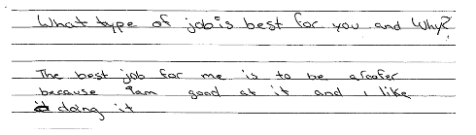
What Does It Look Like?
Essential Skills Level 1 - beginning

Slide 24
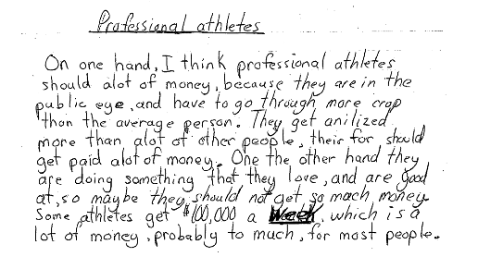
Limited Literacy Skills
Essential Skills Level 1 – end

Slide 25
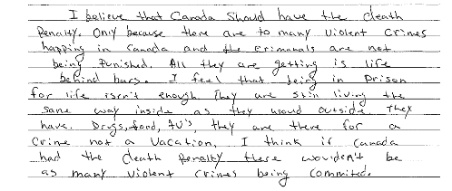
Limited Literacy Skills
Essential Skills Level 2

Slide 26
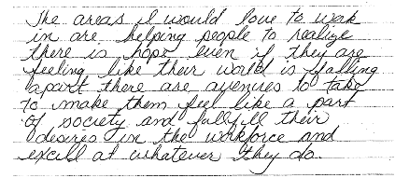
Limited Literacy Skills
Essential Skills Level 2

Slide 27
Readiness to learn
Not all clients who need skills upgrading will be ready to learn
Barriers:
Mental health and medication
Basic Needs aren’t being met (housing, food, etc.)
Other – i.e. feeling of being forced to be at any agency

Slide 28
Literacy
It’s a four-syllable word!!!!
Has started to take on the “politically incorrect” connotation
“Illiterate” is rarely used
Even Essential Skills can make people think of life-skills
So what do you say instead….

Slide 29

Upgrading
Skills Upgrading
GED Preparation
Employment readiness training
Adult Upgrading
Adult Learning

Slide 30

Fear of School
May have had a bad experience at school (and the stories become worse as the years go by)
Probably didn’t do well at school and felt “stupid”
School structure didn’t work

Slide 31
Fear of School - Solved
Different game as an adult
Adult learning principles are used
More equality between instructor and learner
Learner-centred or learner-driven
Learning is only related to the adult’s goal and goal path
The learner can say, “No!”

Slide 32
Six Principles of Adult Learning
Adults are internally motivated and self-directed
Adults bring life experiences and knowledge to learning experiences
Adults are goal oriented
Adults are relevancy oriented
Adults are practical
Adult learners like to be respected

Slide 33
I’m looking for a job…I don’t have time for school
Learning happens at various times and locations
The client can do as little as 2 hours/week
Most programs are flexible about part-time and full-time programming
Upgrading can help you improve your chances of moving up in the company; more job security; increase your earning potential

Slide 34

Project READ
Centralized assessment
Centralized referral point
Our job to know all the educational programs
We can help to screen a client and refer by phone
We can support your screening questions and concerns
We can talk to your clients/candidates to help sell upgrading

Slide 35
Waterloo Region – LBS Programs
Conestoga College
Core Essentials – St. Louis
Essential Skills Upgrading – WRDSB
The Literacy Group of Waterloo Region
All programs provide services in K-W and Cambridge

Slide 36

Introduction to Preparatory Programs at Conestoga College

Slide 37

Programs Overview
Academic Upgrading
Career Exploration
Discover Your Future
Focus for Change

Slide 38
Purposes of Academic Upgrading
1. College / Apprenticeship preparation
Our courses are accepted for admission into college and apprenticeship programs
2. GED test preparation
We prepare people for this high school equivalency test
3. Employment preparation
We can help brush up reading, writing, and math skills for the workplace

Slide 39
Classroom Structure for Academic Upgrading
Classes are set up in a self-directed format - students work individually, but one-on-one help is available
Classes run from 9:00 a.m.- 2:00 p.m., Monday to Friday, but part-time schedules are possible
We run continuous intake; new students start regularly throughout the year (except for summer closure in July & August)
First step is an academic assessment or GED pre-test

Slide 40
Career Exploration
We have two career exploration programs
These programs run from 9:00 – 2:00, Monday to Friday (full time attendance is a must)
 | Discover Your Future | Focus for Change
Start Date | January & April | September
Length | 10 weeks | 14 weeks
Eligibility | Everyone | Women receiving OW/ ODSP

Slide 41
Career Exploration cont’d
There are 5 areas of study in these programs
Personal Management
Problem-solving skills, effective interpersonal relations
Career Building
Assessment of personal abilities, creation of employment/training plan
Employment Strategies
Job search, resumes, interviews, job shadow period
Academic Review
English and math assessment and review
Computer Literacy
Overview of Microsoft Word, Excel, PowerPoint, and email

Slide 42




Core Essentials at
St. Louis

Slide 43

Helps Learners update Essential Skills for learning, work and life including:
Math • Writing • Reading • Document Use

Slide 44


Our niche is working with learners who have identified an SSC goal path

Slide 45
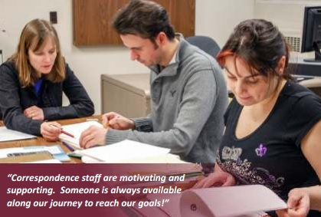
Helps Learners Prepare for:
Secondary School Credit Courses

Slide 46

Helps Learners Prepare for:
PLAR Assessments

Slide 47
Offers Learners:
Small Classes (10 students per instructor)
Qualified instructors to help with self-directed learning
Customized instruction for the skills needed for goal
Reasonable timelines and pace to allow for individual differences

Slide 48
Other Considerations:
Our programs are Free
Learners can attend full time or part time
Transportation and childcare subsidies are available for qualifying learners

Slide 49
Who is Eligible:
Adults aged 19 and older
ESL Learners who have achieved CLB of 6

Slide 50
Core Essentials
NEW LOCATION
St. Louis: Kitchener Main
70 Young Street , Kitchener
St. Louis: Cambridge Annex
(behind St. Benedict’s school)
50 Saginaw Pkwy, Cambridge
Morning Class
Monday-Thursday 8:45-11:45
Afternoon Class
Monday-Thursday 12:30-3:00

Slide 51
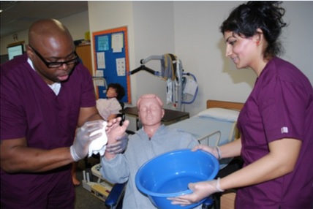
PSW Essentials
A Boutique Program that prepares learners
for St. Louis’
School-to-Work: Personal Support Worker Program

Slide 52
PSW Essentials
Prepares Learners by building strengths in:
Communicating ideas
Finding information
Learning and memory
Study skills
Listening and Note taking
Stress management
Strategies for test taking

Slide 53
PSW Essentials
NEW LOCATION
St. Louis: Kitchener Main
70 Young Street , Kitchener
St. Louis: Cambridge Annex
(behind St. Benedict’s school)
50 Saginaw Pkwy, Cambridge
Program runs evenings
(6:00pm-8:30pm) and is offered ahead of PSW program start dates

Slide 54

Hair Essentials
A Boutique Program that prepares learners
for St. Louis’
School-to-Work: Hairstylist Program

Slide 55
Hair Essentials
Prepares Learners by building strengths in:
Communicating ideas
Finding information
Numeracy for the business environment
Learning and memory
Study skills
Listening and Note taking
Stress management

Slide 56
Hair Essentials
St. Louis: Kitchener Main
70 Young Street , Kitchener
Program runs evenings
(6:00pm-8:30pm) and is offered leading up to Hairstylist program start dates

Slide 57

Free employment-focused upgrading for adults
ESU: Essential Skills Upgrading
A Continuing Education Program

Slide 58
ESU is an adult learning program that helps people:
Prepare for employment
Prepare to write the GED
Prepare for further training.
Notes:
ESU’s niche

Slide 59

Improve Reading Text skills for
Manuals
Policies
Procedures
Emails
Reports
GED test

Slide 60

Improve Writing skills for
Emails
Memos
Procedures
Notes
GED test

Slide 61

Improve Document Use skills for
Reading charts and tables
Reading schedules
Job applications
Invoices
GED test

Slide 62

Improve Numeracy skills for
Working with money
Filling out invoices
Measurement
Budgeting
GED test

Slide 63

Improve Working with Others skills
Notes:
ESU recognizes that employers are looking for soft skills as well as literacy and numeracy skills. This year, ESU piloted a soft skills curriculum that created a forum for conversations about topics such as work ethic, problem solving, team work, and nonverbal communication.

Slide 64

Improve Computer Use skills for
Microsoft Office
Email
Internet use
Notes:
We offer computer training for learners who are also upgrading their numeracy or literacy skills

Slide 65

pre-GED @ ESU
While getting the skills needed for work,
learners can see how to use the same skills to pass the GED test.

Slide 66
Eligibility
At least 19years old
In need of numeracy or literacy skills
Canadian Language Benchmark level 7 in speaking and listening, reading and writing*
*2014 LBS-ESL Guidelines approved by Waterloo and Wellington Literacy Committees of Project READ Literacy Network
Notes:
“In need of numeracy or literacy skills” point is to say that we can only offer computer upgrading to adults who also need numeracy or literacy upgrading

Slide 67
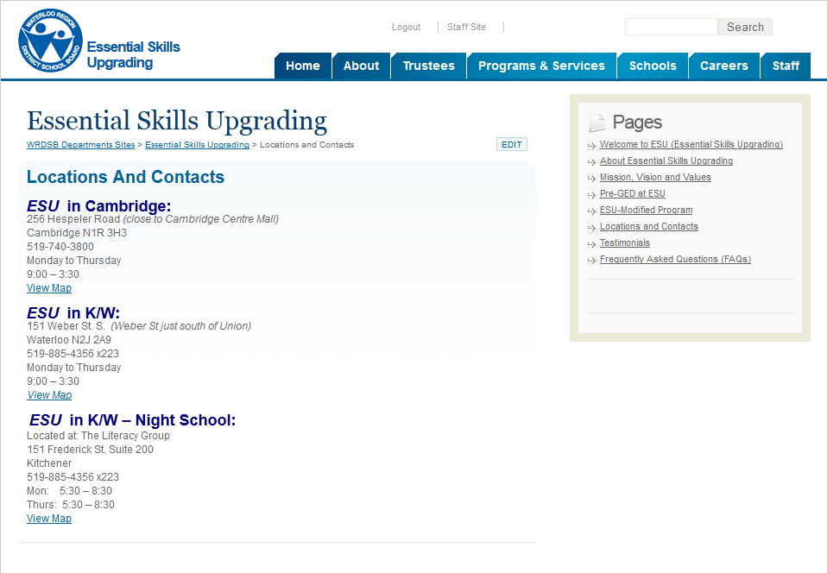
Visit our website: www.wrdsb.ca/esu

Slide 68
Structure and Programs

Slide 69
We provide
One to One tutoring
Trained volunteer tutors
Learners have individual learning plans
Matches meet for 2 hours a week
Small group
Learners can work within a small group
Each learner creates an individualized learning plan
Each learner works in a group best set for their level, goal path and availability
Each learner can have 6 hours a week learning time
Learners are encouraged to have a tutor and work within groups to maximise their learning.
We review each learner’s progress every 3 months.
We pride ourselves on preparing the learner to move on to the next step in a time period of 1- 2 years, however there are always specific cases where it could be more or less.

Slide 70
Groups
Living and Learning
Learn to read to become fluent readers, improve quality of life and learn daily living skills.
Goal Path: Independence.
Level: Emergent and low level 1.
3 hours, twice a week.
Learning to Read
Write simple notes
Read food labels
Basic whole number use
Basic spelling skills and phonics
Basic computer skills including internet use
Soft skills – interacting with others
Reading to Learn
Write to request and thank
Read newspapers and continuous text
Basic number decimal and fraction operations
More advanced computer skills
Soft skills – giving direction and information

Slide 71
Groups
Academic Foundations
To prepare learners for academic learning and secondary school upgrading.
Goal Path: Secondary and Apprenticeship.
Level: Level 1 and emergent 2.
3 hours, twice a week.
Learning to Learn
Sentence structure and punctuation
Comprehension
Research techniques
Whole number and long operations
Microsoft Office
Soft skills – time management
Pre GED Preparation
How to answer exam style questions
Revising skills
Essay writing
Critical thinking
Higher level numeracy
Soft skills – goal target setting

Slide 72
Groups
Workplace Essentials
To develop all skills required by employers.
Goal path: Employment.
Level: Level 1 and emergent 2.
Day - 3 hours twice a week
Understanding the Essential Skills
Document use
Time, data and money management
Internet use
Microsoft Office
WHMIS
Touch screen tablet /POS
Conflict resolution
Teamwork and communication
Evening – 2 hours twice a week
Document use
Time management
Understanding NOC codes
Microsoft Office
WHMIS training
Conflict resolution and direction giving
Teamwork exercises

Slide 73

Tailored Programs
At The Literacy Group we have:
A state of the art computer suite
5 experienced and qualified educators
The latest resources in adult education
A wealth of 15 years in adult education
We can tailor a program suitable for your clients.
Within TLG we are running a number of additional tailor made courses, including:
Computer courses
Essential skills training in the work place
Literacy in the workplace
Financial numeracy
If you know of a group of clients who are need of particular upgrading, we can create the right package for them.

Slide 74
Group Work
Break into your original groups of 3 or 4 people
A different person will be the employment counsellor
A different person will be the client (using the scenario we give you)
One or two people will be the scribes taking notes and offering suggestions

Slide 75
Group Work – Wrap Up
Any key observations?

Slide 76

Evaluations
Please complete the reverse side of the workshop evaluation
Thank you for your time and the effort you put into supporting individuals with employment goals!

Slide 77

Gratuitous Puppy Shot!

